Slide 1
Supermarket Billing System
Presented BY: presented to:
HIRA ASLAM dr.asif nauman
Hanzla baSHIR

Slide 2
Application Overview:
The Supermarket Billing System is a software application designed to facilitate efficient billing processes in a supermarket environment. It allows the cashier or store attendant to add items, calculate the total bill, display it to the customer, and optionally save the bill details to a file.
TOOLS AND TECHNIQUES:
C++
Visual Studio Code (VS code)

Slide 3
Key Features:
Sign-up: New user can sign-up its new accout when he want to use the program.
Login: User can login it’s account when he want to use the program.
Add Item: Enables the user to input details such as product name, price, and quantity for each item being purchased.
Display Bill: Presents a comprehensive bill summary including the product name, price, quantity, and total amount for each item, along with the grand total.
Write Bill to File: Offers the functionality to save the bill details to a text file for record-keeping or printing purposes.
User-friendly Interface: Utilizes a simple menu-based interface for easy navigation and operation.

Slide 4
Usage Scenario:
Scenario: A cashier at a supermarket needs to generate a bill for a customer's purchase.
Steps:
The cashier Login it’s account by his username and password.
The cashier selects the "Add Item" option from the menu and enters the details for each product.
Once all items are added, the cashier selects the "Display Bill" option to show the customer the total amount to be paid.
If required, the cashier can choose the "Write Bill to File" option to save a copy of the bill for future reference.
Finally, the cashier can exit the application by selecting the "Exit" option.

Slide 5
Explanation of Key Functions:
displayMenu(): Displays the main menu options for the user to choose from.
getProducts(): Allows the user to input details for each product being purchased, including its name, price, and quantity.
displayBill(): Prints a formatted bill summary on the console, showing details of each item along with the grand total.
writeBillToFile(): Writes the bill details to a text file specified by the user, including product information and the grand total.
bool signIn() : Handles user sign-up
bool login() : Handles user login
void getCustomerDetails(Customer& customer) : Gets the customer details

Slide 6
Importance for Presentation:
Efficiency: The application streamlines the billing process, saving time for both the cashier and the customer.
Accuracy: By automating calculations, it reduces the risk of manual errors in bill generation.
Record-keeping: The ability to save bills to a file enables the store to maintain organized records for auditing and customer service purposes.
User-Friendly: With its intuitive interface, even users with minimal technical knowledge can operate the system effectively.

Slide 7
Conclusion:
The Supermarket Billing System offers a practical solution for managing billing operations in a supermarket setting. Its features promote efficiency, accuracy, and ease of use, making it a valuable tool for both store staff and customers.

Slide 8
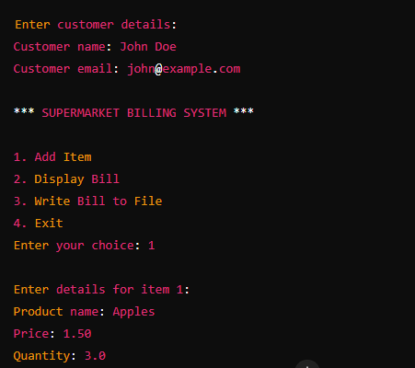
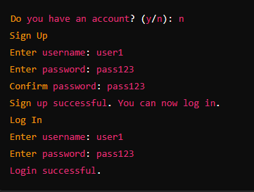
OUT PUT :

Slide 9
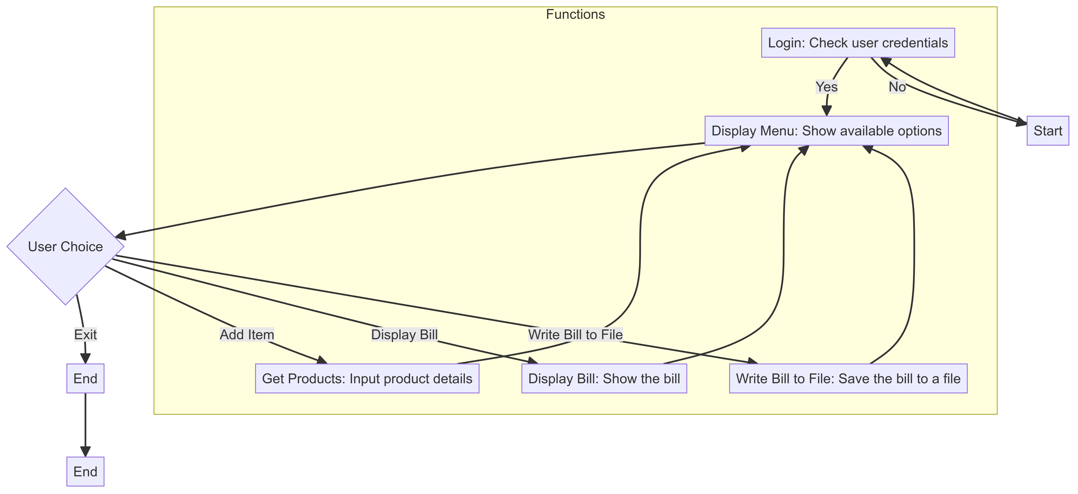
FLOW CHART

